Slide 1

HR RECRUITMENT
SUBMITTED BY :- DARSHIKA SINGH

Slide 2

TABLE OF
CONTENTS
• Reading HR data into python
• Recruitment Analysis
• Avg sales by recruiting source
with atrrition 0 and 1
• Visualize Attrition differences
by Recruiting Source
• Visualize Sales differences by
Recruiting Source

Slide 3
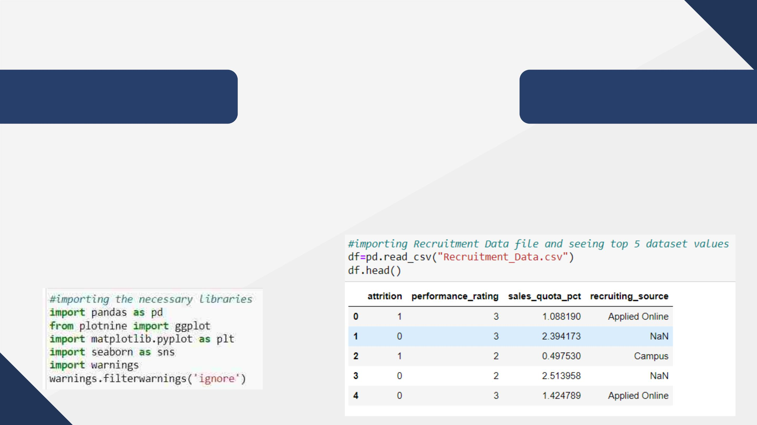
READING
DATA
Reading HR data into
python

Slide 4
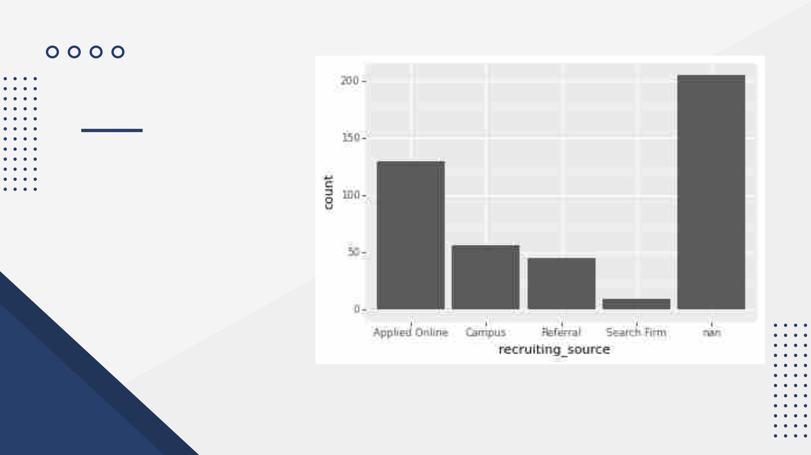
RECRUITMENT
ANALYSIS
Applied online is the most
common way of recruitment.

Slide 5
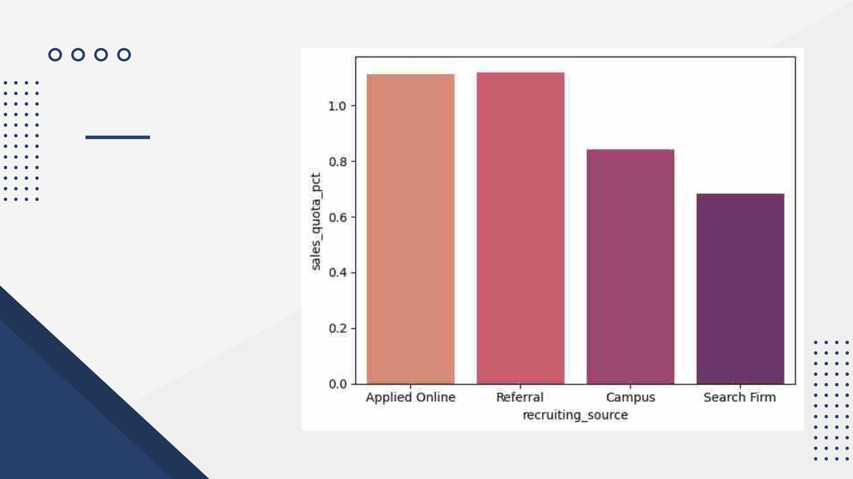
ATTRITION
NUMBER 0 :-
AVG SALES BY
THE
RECRUITING
SOURCE

Slide 6
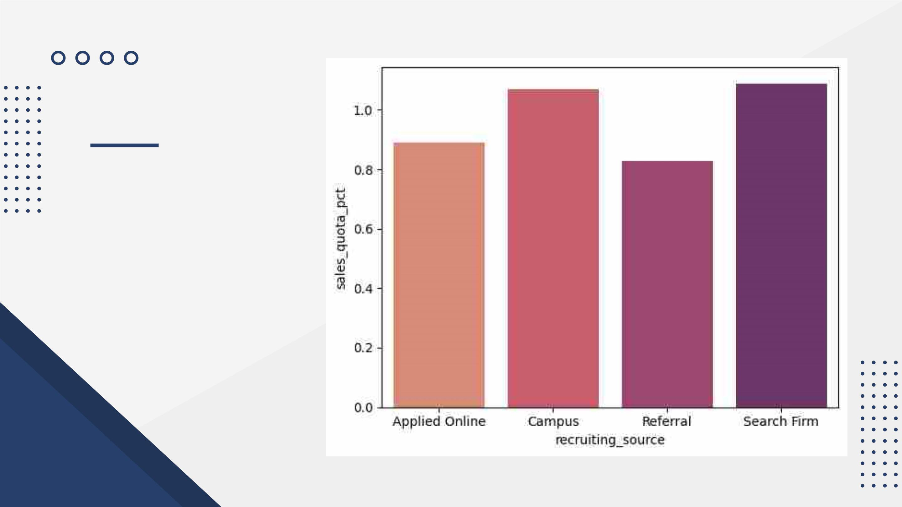
ATTRITION
NUMBER 1 :-AVG
SALES BY THE
RECRUITING
SOURCE

Slide 7
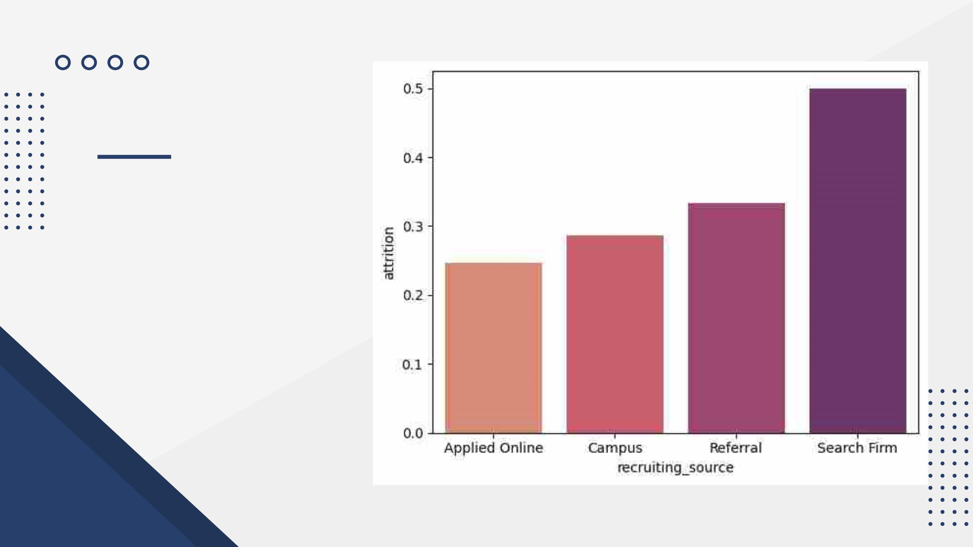
GROUPING
ATTRITION
NUMBER BY THE
RECRUITING
SOURCE

Slide 8
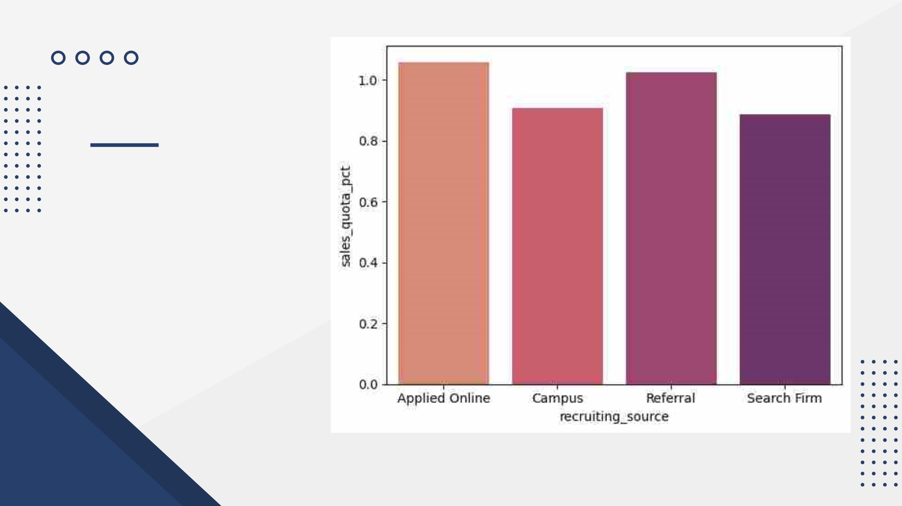
SALES
DIFFERENCES
BY RECRUITING
SOURCE

Slide 9

RECRUITING
SOURCES
Campus
Search Firm
56 candidates are
hired from campus
10 candidates are
hired from search
firm
Applied Online
Referral
130 candidates
have applied online
45 candidates are
hired from referrals

Slide 10

KEY
INSIGHTS
• After grouping by recruiting
source we can see that minimum
attrition is done by applied online
category.
• After grouping by recruiting source
we can see that maximum average
sales is from applied online and
referral category.

Slide 11

RECOMMENDATION
• Applied online and referral
recruiting sources have high
Sales numbers and low Attrition
numbers.
• Applied Online is the best source
of recruitment for a tech startup

Slide 12

THANK
YOU

